Slide 1
Air as a Resource

Slide 2
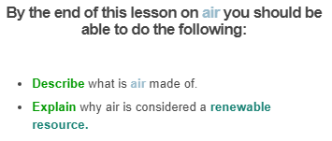


Slide 3

You might think that air is just a gas, but it's actually much more than that!
Air is a mixture of gases... |  | and suspended particles.
• Oxygen |  | • Dust
• Carbon Dioxide |  | • Smoke
• Nitrogen |  | • Water Droplets
• Water Vapour

Slide 4
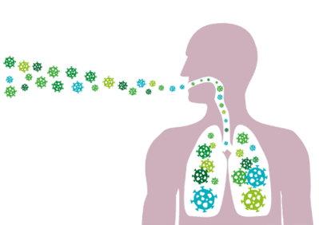

The gases in the air are important to support life on Earth.
Oxygen is essential for most living things to use and store the energy they get out of food.
Carbon dioxide allows plants to make their own food via a process called photosynthesis.

Slide 5
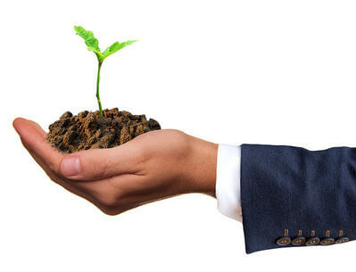

Nitrogen provides plants with the nutrients they need to make proteins.
Water vapour is a part of the water cycle which carries water to different parts of the planet.

Slide 6
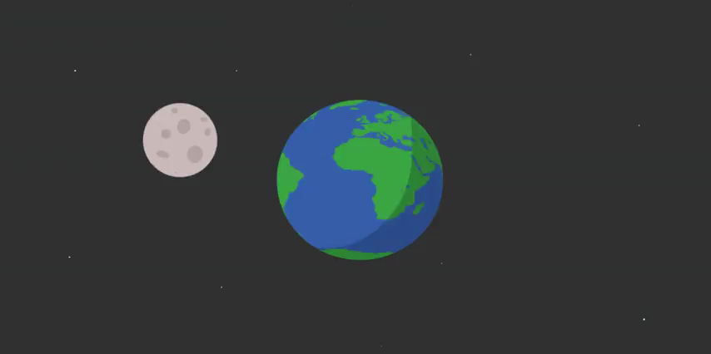
Air is one of Earth's resources.
There are a lot of living things which need to use the air to survive. For example, there are over 7 billion people on the planet, and all of these people need oxygen to survive!
So what stops us from running out of oxygen?

Slide 7

All gases in the air, such as oxygen, carbon dioxide, and nitrogen, are constantly being recycled and replaced.
This means that the level of gases in the air stays the same, no matter how many things are using it.
Therefore, air is a renewable resource!

Slide 8
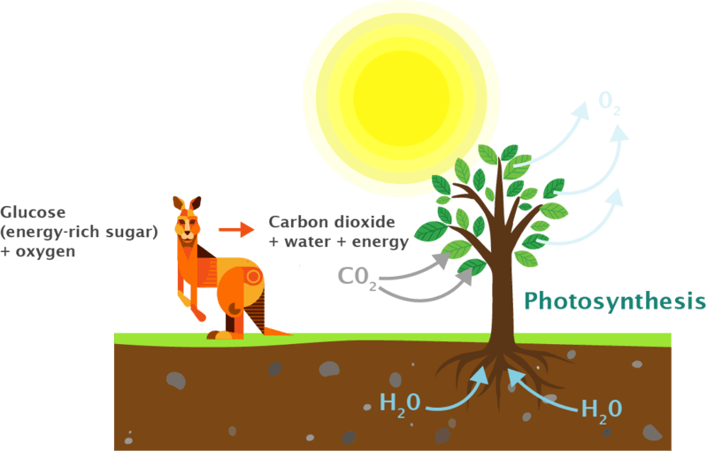
Plants and animals use oxygen to get energy from food, but this oxygen is replaced as plants carry out photosynthesis.

Slide 9
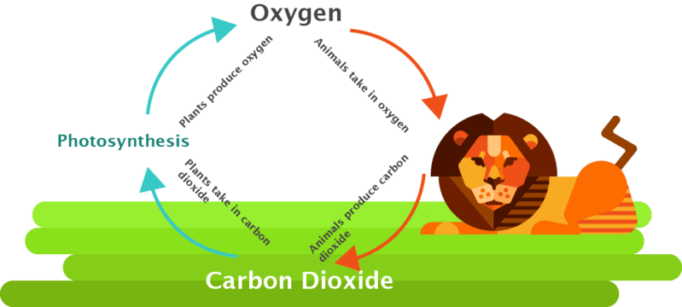
Photosynthesis is carried out by green plants. It takes carbon dioxide out of the air and turns it into oxygen.
The carbon dioxide is replaced when animals breathe it out.
This keeps the levels of carbon dioxide and oxygen in the air the same.

